Slide 1

Python programming applied to Finance - 2
Jean-Damien VILLIERS

Slide 2
Python programming applied to Finance - 2
Python 1:
Fundamentals for python
Introduction to main Data Science packages for finance: Pandas, Numpy, Scipy, Matplotlib
Learning Google Colab / Jupyter
Python 2:
Python object oriented programming
SQL in python
Python and VBA
Advanced python syntax
Setting up an object oriented Monte-Carlo pricer
Interactive dashboards in Jupyter

Slide 3
Glossary
Reminder on Pandas and Numpy
Advanced Python Syntax
Reading and Writing files
Python Object Oriented Programming (OOP)
Connecting Python (SQL, VBA, API)
Multithreading / Parallel programming
Interactive Dashboards
Projects

Slide 4
1. Reminder on Pandas and Numpy

Slide 5
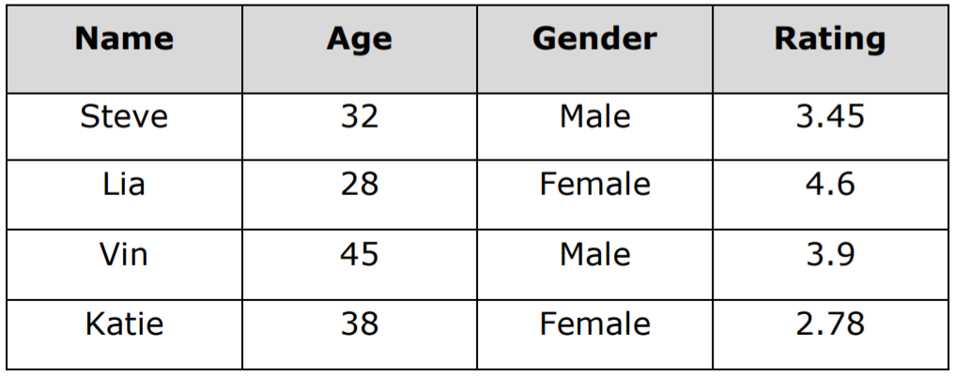
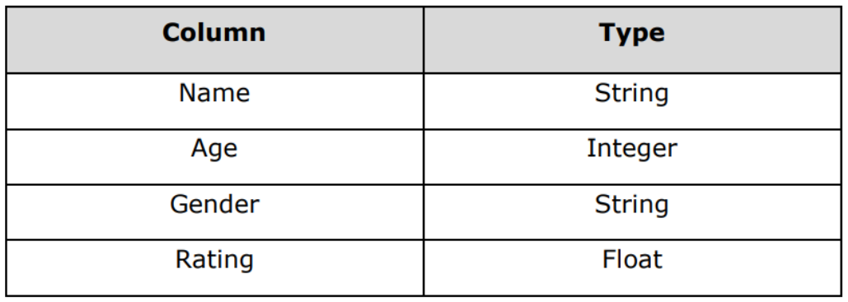
What is Pandas ?
Pandas is an open source, BSD-licensed library
High-performance, easy-to-use data structures and data analysis tools
Offers data structures and operations for manipulating numerical tables, time series and dataframes
Example of Dataframe
1.Pandas and Numpy

Slide 6
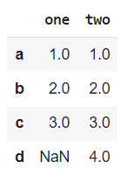
Pandas - Create a dataframe
import pandas as pd
d = {"one" : pd.Series ([1. , 2. , 3.] ,index =[ "a", "b", "c"]) ,"two" : pd.Series ([1. , 2. , 3. , 4.] , index=[ "a", "b", "c", "d"]) }
df = pd.DataFrame(d)
df
1.Pandas and Numpy

Slide 7
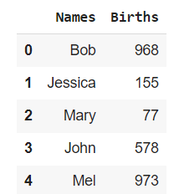
Pandas - Create a data frame and write to a csv file
import pandas as pd
names = ['Bob','Jessica','Mary','John','Mel']
births = [968 , 155 , 77 , 578 , 973]
#To merge these two lists together we will use the zip function .
DataSet = list (zip ( names , births ) )
df = pd.DataFrame ( data = DataSet,columns =[ 'Names ', 'Births'])
df.to_csv ('births.csv', index = False , header = False )
1.Pandas and Numpy

Slide 8
Pandas - Import data from csv file
>>> df = pd.read_csv ( filename )
#Don ’t treat the first row as a header >>> df = pd.read_csv ( Location , header = None )
# Provide specific names for the columns >>> df = pd.read_csv ( Location , names =[ ’Names ’,’Births ’])
1.Pandas and Numpy

Slide 9
Pandas - Add a column
>>>d = [0 ,1 ,2 ,3 ,4 ,5 ,6 ,7 ,8 ,9]
# Create dataframe >>> df = pd.DataFrame(d)
# Name the column >>> df.columns = [’Rev ’]
#Add another one and set the value in that column >>> df [’NewCol ’] = 5
1.Pandas and Numpy

Slide 10
Pandas - Accessing and indexing the data
# Perform operations on columns >>> df [’NewCol ’] = df [’NewCol ’] + 1
# Delete a column >>>del df [’NewCol ’]
# Edit the index name >>>i = [’a’,’b’,’c’,’d’,’e’,’f’,’g’,’h’,’i ’,’j’] >>> df . index = i
1.Pandas and Numpy

Slide 11
Pandas - Accessing and indexing the data
# Find based on index value >>> df . loc [’a’] >>> df . loc [’a’:’d’]
#Do integer position based indexing >>> df . iloc [0:3]
# Access using the column name >>> df [’Rev ’]
# Access multiple columns >>> df [[ ’Rev ’, ’test ’]]
# Subset the data >>> df . ix [:3 ,[ ’Rev ’, ’test ’]]
1.Pandas and Numpy

Slide 12
Pandas - Query the data / Apply Functions
Query Data
>>> df . query (’one > 0’) one two three c 0.110718 -0.016733 -0.137009 e 0.153456 0.266369 -0.064127 f 1.709607 -0.424790 -0.792061
>>> df.query (’one > 0 & two > 0’) one two three e 0.153456 0.266369 -0.064127
1.Pandas and Numpy

Slide 13
Pandas: useful functions / actions
Pandas function | Description
pd.read_csv() | Allows to read data and load a CSV file as a dataframe
df.to_csv() | Allows to export a dataframe to a CSV file
df.assign() | Create a new column assigning a column name to a formula
df.query() | To find a subset of the columns
df.sort_values() | Allows to sort a DataFrame by ascending / descending order
df.describe() | To get a summary with statistics
df.info() | To get information about the dataframe (type of objects, header etc…)
df.merge() | To join tables
1.Pandas and Numpy

Slide 14
Pandas: useful functions / actions
Pandas function | Description
df.sample() | To get random rows of the dataframe
df.dropna() | To drop rows wih NA values
df.drop() | To drop specific columns
pd.pivot_table() | To create a pivot table from an existing dataframe
df.groupby() | To perform aggregation
df.transpose() | To transpose a table
df.rename() | To rename a column
1.Pandas and Numpy

Slide 15
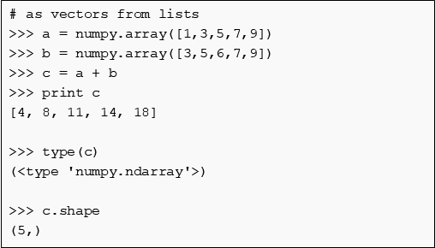
Numpy arrays
There are a number of ways to initialize new numpy arrays, for example from
a Python list or tuples
using functions that are dedicated to generating numpy arrays, such as arange, linspace, etc.
reading data from files
1.Pandas and Numpy

Slide 16
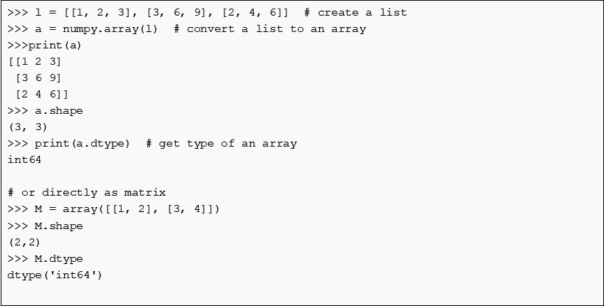
Numpy matrices
1.Pandas and Numpy

Slide 17
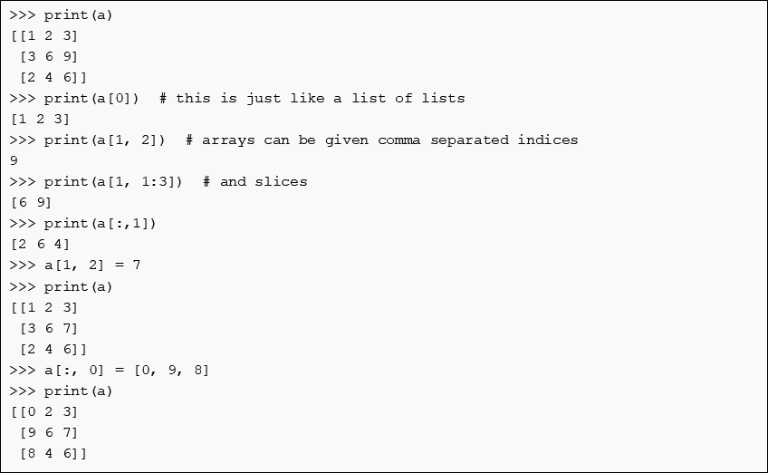
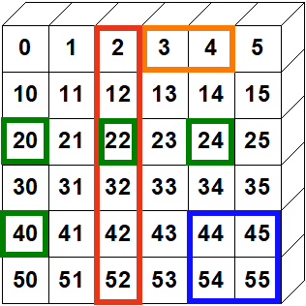
Numpy arrays manipulation
1.Pandas and Numpy

Slide 18
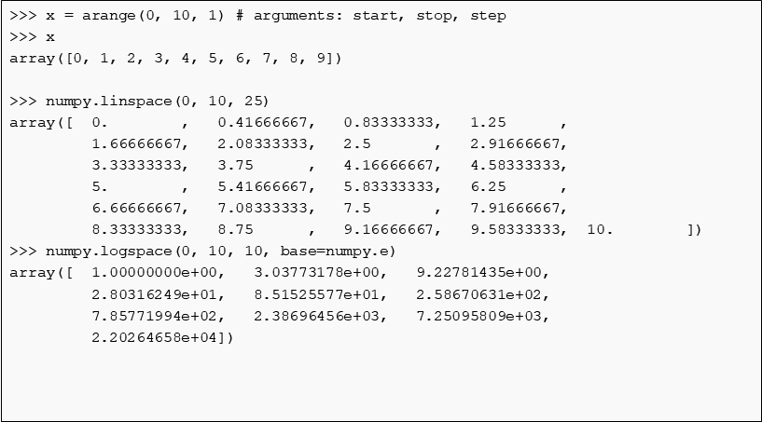
Numpy useful functions to generate arrays
1.Pandas and Numpy

Slide 19
Numpy useful methods
>>> arr.sum()
145
>>> arr.mean()
14.5
>>> arr.std()
2.8722813232690143
>>> arr.max()
19
>>> arr.min()
10
>>> arr = numpy.array([4.5, 2.3, 6.7, 1.2, 1.8, 5.5])
>>> arr.sort() # acts on array itself
>>> print(arr)
[ 1.2 1.8 2.3 4.5 5.5 6.7]
1.Pandas and Numpy

Slide 20
Numpy - Statistics
In addition to the mean, var, and std functions, NumPy supplies several other methods for returning statistical features of arrays. The median can be found:
>>> a = np.array([1, 4, 3, 8, 9, 2, 3], float)
>>> np.median(a)
3.0
The correlation coefficient for multiple variables observed at multiple instances can be found for arrays of the form [[x1, x2, …], [y1, y2, …], [z1, z2, …], …] where x, y, z are different observables and the numbers indicate the observation times:
>>> a = np.array([[1, 2, 1, 3], [5, 3, 1, 8]], float)
>>> c = np.corrcoef(a)
>>> c
array([[ 1. , 0.72870505],
[ 0.72870505, 1. ]])
1.Pandas and Numpy

Slide 21
2. Advanced Python Syntax

Slide 22
Built-in features: lambda function
A Lambda Function is a small, anonymous function — anonymous, meaning here that it doesn't really have a name.
Python functions are usually defined using the style of def XXX() , but with lambda functions we don’t need to give a name. Lambda functions are generally used to perform simple expressions / operations without the need of fully defining a new functions.
A lambda function can take any number of arguments, but must always have only one expression. It is usually used to perform basic math operations, and allows to write simpler / cleaner python code.
x= lambda a, b, c : a * b *c
print(x(5, 6, 7))
x = lambda a : a*2 + 2
print(x(3))
2.Advanced Python Syntax

Slide 23
Built-in features: MAP
Map is a built-in Python function used to apply a function to a sequence of elements like a list or dictionary. It provides a more readable way to perform such an operation.
def square_function(a):
return a * a
x = map(square_function, [1, 2, 3])
print(x)
print(list(x))
<map object at 0x0000021619526A58>
[1, 4, 9]
2.Advanced Python Syntax

Slide 24
Built-in features: MAP
By using map we can apply our functions to a single list or multiple lists. Note that the map function returns a map object type. To display its content we need to convert it to a list.
def item_item_multiplier(a, b):
return a * b
x = map(item_item_multiplier, [1, 4, 7, 9], [2, 5, 8, 4])
print(x)
print(list(x))
<map object at 0x00000216195265F8>
[2, 20, 56, 36]
2.Advanced Python Syntax

Slide 25
Built-in features: Filtering
The filter built-in function is similar to the Map function, it allows to apply a function to a sequence (list, tuple, dictionary). The key difference is that filter() will only returns the elements for which the applied function returns True.
# Our numbers
numbers = [1, 2, 3, 4, 5, 6, 7, 8, 9, 10, 11, 12, 13, 14, 15]
def filter_odd_numbers(num):
if num % 2 == 0:
return True
else:
return False
filtered_numbers = filter(filter_odd_numbers, numbers)
print(filtered_numbers)
print(list(filtered_numbers))
<filter object at 0x0000021619526860>
[2, 4, 6, 8, 10, 12, 14]
2.Advanced Python Syntax

Slide 26
Built-in features: ZIP
Zip makes an iterator that aggregates elements from each of the iterables.
It returns an iterator of tuples, where the i-th tuple contains the i-th element from each of the argument sequences or iterables. The iterator stops when the shortest input iterable is exhausted. With a single iterable argument, it returns an iterator of 1-tuples
x = [1, 2, 3]
y = [4, 5, 6]
zipped = zip(x, y)
list(zipped)
[(1, 4), (2, 5), (3, 6)]
2.Advanced Python Syntax

Slide 27
Built-in features: ZIP
Zip is convenient to iterate over several lists in parallel. Zip is also frequently combined with the built-in function enumerate to iterate over two lists and their indices:
alist = ['a1', 'a2', 'a3']
blist = ['b1', 'b2', 'b3']
for i, (a, b) in enumerate(zip(alist, blist)):
print(i, a, b)
0 a1 b1
1 a2 b2
2 a3 b3
2.Advanced Python Syntax

Slide 28
Generators
Python generators are a simple way of creating iterators. A simple definition of generator is a function that returns an object (iterator) which we can iterate over (one value at a time)
Creating a python generator is as easy as defining a normal function with yield statement instead of a return statement.
If a function contains at least one yield statement (it may contain other yield or return statements), it becomes a generator function. Both yield and return will return some value from a function. The difference is that, while a return statement terminates a function entirely, yield statement pauses the function saving all its states and later continues from there on successive calls.
2.Advanced Python Syntax

Slide 29
Generators
def my_generator():
n = 10
print('First print')
yield n # Generator function contains yield statements
n += 1
print('Second print')
yield n
n += 1
print('Third print')
yield n
x=my_generator()
list(x)
First print
Second print
Third print
[10, 11, 12]
2.Advanced Python Syntax

Slide 30
Generators
Interactive run of functions:
x=my_generator()
next(x)
First print
10
next(x)
Second print
11
2.Advanced Python Syntax

Slide 31
Generators
We note that the value of variable n is remembered between each call. Unlike normal functions, the local variables are not destroyed when the function yields.
We can also use generators with for loops directly:
for z in my_generator():
print(z)
2.Advanced Python Syntax

Slide 32
Generators
Differences between Generator function and a Normal function:
Generator function contains one or more yield statement.
Generators return an object (iterator) but does not start execution immediately.
Once the function yields, the function is paused and the control is transferred to the caller.
Local variables and their states are remembered between successive calls.
When the function terminates, StopIteration is raised automatically on further calls.
2.Advanced Python Syntax

Slide 33
Generators
One of the main reasons Generators are used is that they are simple to implement, they make Python code faster, and they reduce memory usage. Below an example:
def check_even1(numbers):
even = []
for num in numbers:
if num % 2 == 0:
even.append(num*num)
def check_even2(numbers):
for num in numbers:
if num % 2 == 0:
yield num * num
2.Advanced Python Syntax

Slide 34
Generators
if __name__ == '__main__':
m1 = memory_profiler.memory_usage()
t1 = time.process_time()
cubes = check_even1(range(50000000))
t2 = time.process_time ()
m2 = memory_profiler.memory_usage()
time_diff = t2 - t1
mem_diff = m2[0] - m1[0]
print(f"It took {time_diff} Secs and {mem_diff} Mb to execute this method")
Check_even1 => It took 6.491964637000001 Secs and 1158.68359375 Mb to execute this method
Check_even2 => It took 9.000000000014552e-05 Secs and 0.0 Mb to execute this method
2.Advanced Python Syntax

Slide 35
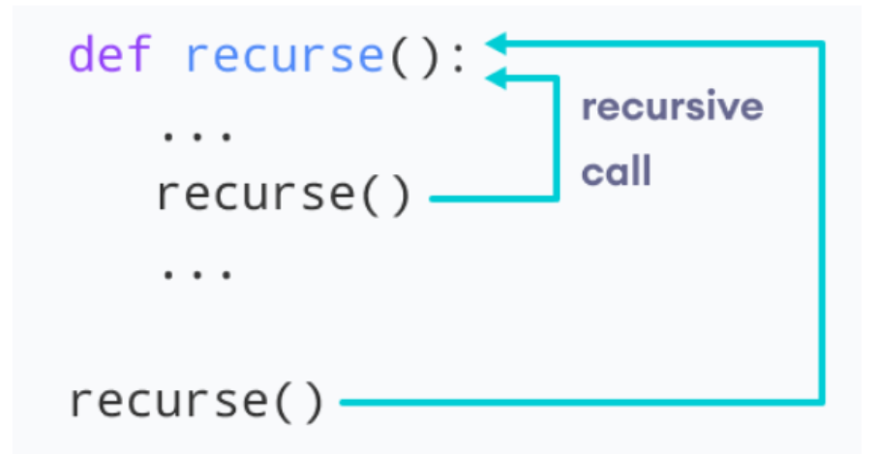
Recursive functions
In python we know that a function can call other functions. We name by "recursive" function a function which calls itself.
def factorial(x):
"""This is a recursive function
to find the factorial of an integer"""
if x == 1:
return 1
else:
return (x * factorial(x-1))
num = 3
print("The factorial of", num, "is", factorial(num))
2.Advanced Python Syntax

Slide 36
Exercises - Advanced Syntax
2.Advanced Python Syntax

Slide 37
3. Reading and Writing files

Slide 38
Obtaining References to Files
Reading from, and writing to, text files in Python is relatively straightforward. The built in open() function creates a file object for you that you can use to read and/ or write data from and/ or to a file.
The function requires as a minimum the name of the file you want to work with. Optionally you can specify the access mode (e.g. read, write, append etc.).
The syntax for the open() function is
file_object = open(file_name, access_mode)
Where
file_name indicates the file to be accessed.
access_mode The access_mode determines the mode in which the file is to be opened, i.e. read, write, append, etc. A complete list of possible values is given below in the table. This is an optional parameter and the default file access mode is read (r).
Reading and Writing files

Slide 39
Obtaining References to Files
The access_mode values are given in the following table.
r | Opens a file for reading only. The file pointer is placed at the beginning of the file. This is the default mode
rb | Opens a file for reading only in binary format. The file pointer is placed at the beginning of the file. This is the default mode
r+ | Opens a file for both reading and writing. The file pointer placed at the beginning of the file
rb+ | Opens a file for both reading and writing in binary format. The file pointer placed at the beginning of the file
w | Opens a file for writing only. Overwrites the file if the file exists. If the file does not exist, creates a new file for writing
wb | Opens a file for writing only in binary format. Overwrites the file if the file exists. If the file does not exist, creates a new file for writing
w+ | Opens a file for both writing and reading. Overwrites the existing file if the file exists. If the file does not exist, creates a new file for reading and writing
wb+ | Opens a file for both writing and reading in binary format. Overwrites the existing file if the file exists. If the file does not exist, creates a new file for reading and writing
Reading and Writing files

Slide 40
Obtaining References to Files
The file object itself has several useful attributes such as:
file.closed: returns True if the file has been closed (can no longer be accessed because the close() method has been called on it).
file.mode: returns the access mode with which the file was opened.
file.name: The name of the file.
One the file has been opened, Reading data from a text file is supported by:
The read() method. This method will return the entire contents of the file as a single string.
The readline() method reads the next line of text from a file. It returns all the text on one line up to and including the newline character. It can be used to read a file a line at a time.
The readlines() method returns a list of all the lines in a file, where each item of the list represents a single line.
Reading and Writing files

Slide 41
Obtaining References to Files
File Content Iteration:
file = open('myfile.txt', 'r') #open a file in read mode
lines = file.readlines() #returns a list of all the lines
for line in lines: #loop over each item of the list and displays it
print(line, end='')
file.close() #close the file
Writing Data to Files:
print('Writing file')
f = open('my_txt_file.txt', 'w')
f.write('Skema\n')
f.write('Adding extra text \n')
f.close()
This creates a new file called my_txt_file.txt. It then writes two strings to the file each with a newline character on the end; it then closes the file.
Reading and Writing files

Slide 42
Files-processing operation
Renaming files
A file can be renamed using the os.rename() function. This function takes two arguments, the current filename and the new filename. It is part of the Python os module which provides methods that can be used to perform a range of file-processing operations.
import os
os.rename('myfileoriginalname.txt',' myfilenewname.txt')
Deleting Files
A file can be deleted using the os.remove() method. This method deletes the file specified by the filename passed to it.
import os
os.remove('somefilename.txt')
Reading and Writing files

Slide 43
Directories
The os module has several functions that can help with creating, removing and altering directories. These include:
mkdir(): This function is used to create a directory, it takes the name of the directory to create as a parameter. If the directory already exists FileExistsError is raised.
chdir(): This function can be used to change the current working directory. This is the directory that the application will read from/ write to by default.
getcwd(): This function returns a string representing the name of the current working directory.
rmdir(): This function is used to remove/ delete a directory. It takes the name of the directory to delete as a parameter.
listdir(): This function returns a list containing the names of the entries in the directory specified as a parameter to the function (if no name is given the current directory is used).
Reading and Writing files

Slide 44
Exercises: Reading and Writing files
Reading and Writing files

Slide 45
4. Python object oriented programming

Slide 46
Introduction
This chapter explores the concept of Python class - a coding structure and device used to implement new kinds of objects in Python that support inheritance. Classes are Python’s main object-oriented programming (OOP) tool.
We will here introduce the below object oriented concepts:
Python Classes
Object Instances
Defining and working with methods
OOP Inheritance
4.Python OOP

Slide 47
Introduction
Object oriented programming provides a mean to structure the code by creating individual objects which have their own properties and behaviors. It is a way of modelling real word things.
Examples:
An individual has a name, an address, an age which would be seen as its properties (or 'attributes'). He/She is able to walk, talk, run, which represent the possible actions (or 'methods')
A portfolio has a name, a list of deals, a pricing configuration, a currency (the attributes). One could imagine as actions on a portfolio the execution of a pricing or the computation of a VaR ('methods')
4.Python OOP

Slide 48
Introduction
Name : [Paul]
Walk()
Name : [Name]
Walk()
Name : [Pierre]
Walk()
4.Python OOP

Slide 49
Difference between Procedure Oriented and Object oriented Programming
Procedural programming creates a step by step program that guides the application through a sequence of instructions. Each instruction is executed in order.
Procedural programming focuses on the ideal that all algorithms are executed with functions and data that the programmer has access to and is able to change.
OOP is much more similar to the way the real world works: each program is made up of many entities, each entity is an object.
4.Python OOP

Slide 50
Advantages of OOP
Ability to simulate real world events more effectively
Code is re-usable which results in less code has to be written
More appropriate to create GUI (graphical user interface)
Programmers are able to produce faster, more accurate, and better written applications.
4.Python OOP

Slide 51
Fundamental concepts of OOP
Classes
Encapsulation
Data abstraction
Inheritance
Polymorphism
Operator overloading
4.Python OOP

Slide 52
What is a Class ? What is an Instance ?
A class is a special data type which defines how to build a certain kind of object.
The class stores some data items that are shared by all the instances of this class. It contains a state (data, variable) and behavior (set of things that the class can perform).
In Python, classes are created with a new statement: the class. Objects defined with classes can look a lot like be very similar to built-in python types. In fact, classes can be seen as packages of functions that use and process built-in object types. Classes, though, are designed to create and manage new objects, and support inheritance and composition.
4.Python OOP

Slide 53
What is a Class ? What is an Instance ?
class Teacher:
'''A class representing a teacher'''
def __init__(self, n, a):
self.full_name=n
self.age=a
def get_age(self): #Method
return self.age
def set_age(self, num): #Method
self.age=num
4.Python OOP

Slide 54
What is a Class ? What is an Instance ?
Init: __ init __ is the defaul constructor. It serves as a constructor for the class, does the initialization work. It can take any number of arguments. However its first argument needs to be "self".
Self: The first argument of every method is a reference to the current instance of the class. By convention this argument is named "self". In init, self refers t the object currently being created. In other class methodm it refers to the instance whose method was called. You do not give a value to this parameter (self) when you call the method, Python will provide it.
Repr: __repr__ is a special method used to represent a class’s objects as a string. __repr__ is called by the repr() built-in function. You can define your own string representation of your class objects using the __repr__ method.
4.Python OOP

Slide 55
What is a Class ? What is an Instance ?
An instance is the object created which follows the definition given inside the class:
x=Teacher("Peter", 20)
type(x)
__main__.Teacher
4.Python OOP

Slide 56
What is a Class ? What is an Instance ?
Methods in classes:
Methods are the possible actions which can be executed by the object.
In Python the methods are declared by including function definition within the scope of the class block.
Each method contains a special first argument "self" in it definition which get bound to the calling instance.
There is usually a special method called "___ init ___" in most classes
def set_age(self, num): #Method
self.age=num
4.Python OOP

Slide 57
What is a Class ? What is an Instance ?
Calling a method:
x.set_age(25)
Accessing attributes and methods:
x.full_name #Acces an attribute
x.get_age() #Acces a method
4.Python OOP

Slide 58
Encapsulation
An important advantage of OOP consists in encapsulation of data. OOP widely relies on encapsulation.
Encapsulation can be understood as a synonym of "abstraction" or "data hiding".
Generally speaking, encapsulation is the mechanism for restricting access to some of an object's components, which means that the internal representation of an object can't be seen from the outside of the object definition.
Access to this data is typically only achieves through special methods: "Getters" or "Setters".
By allowing only access to get() and set() methods, we make sure that the internal data can't be accidentally corrupted and set into an invalid state.
4.Python OOP

Slide 59
Encapsulation
Public, protected and private data
If an identifier does not start with an underscore "_" it can be accessed from the outside, i.e. the value can be read and changed.
Data can be protected by making members private or protected. Instance variable names starting with 2 underscores characters can't be accessed from outside the class (at least not directly)
If an identifier is only preceded by 1 underscore character, it is a protected member. Protected members can be access like public members from outside the class.
class Encapsulation:
def __init__(self, a,b,c):
self.public=a
self._protected=b
self.__private=c
x=Encapsulation(1,2,3)
1.Python OOP

Slide 60
Encapsulation
print(x.public)
x.public=10
print(x.public)
1
10
print(x._protected)
x._protected=10
print(x._protected)
1
10
print(x.__private)
AttributeError: 'Encapsulation' object has no attribute '__private'
Name | Notation | Behavior
name | Public | Can be accessed from inside or outside
_name | Protected | Like a public member but should not be directly accessed from the outside
__name | Private | Can't be seen and accessed from the outside
4.Python OOP

Slide 61
Inheritance
Inheritance allows us to define a class that inherits all the methods and properties from another class.
Parent class is the class being inherited from, also called base class.
Child class is the class that inherits from another class, also called derived class.
Derived classes inherit features from the base class, adding features to it. This results into re-usability of the code.
4.Python OOP

Slide 62
Inheritance
class BaseClass:
def __init__(self, fname, lname):
self.firstname = fname
self.lastname = lname
def printname(self):
print(self.firstname, self.lastname)
class ChildClass(BaseClass):
def __init__(self, fname, lname):
BaseClass.__init__(self, fname, lname)
self.graduationyear = 2022
x=ChildClass("JD", "V")
x.graduationyear
y=BaseClass("JD", "V")
y.graduationyear
4.Python OOP

Slide 63
Inheritance
While designing a inheritance concept, following points are to be kept in mind:
A subtype never implements less functionalities that the parent type
Inheritance should never be more than two levels deep
We use inheritance when we want to avoid redundant code
4.Python OOP

Slide 64
Polymorphism
Generally speaking, polymorphism means that a method or function is able to cope with different types of input.
In OOP, Polymorphism is the characteristic of being able to assign a different meaning to a particular symbol or operator in different contexts specifically to allow an entity such as a variable, a function or an object to have more than one form.
There are two kinds of polymorphisms:
Overloading: Two or more methods with different signatures.
Overriding: Replacing an inherited method with another having the same signature.
4.Python OOP

Slide 65
Polymorphism
Example of built-in polymorphic function:
# len() being used for a string
print(len("greeks"))
# len() being used for a list
print(len([10, 20, 30]))
Polymorphism with class methods:
1.Python OOP
4.Python OOP

Slide 66
Operator overloading
Python operators work like built-in classes
The same operator behaves differently with different types. For example, the + operator can perform an arithmetic additional on two numbers but can also merge two lists, or concatenate two strings. This feature in Python, which allows the same operator to have different meaning according to the context is called "operator overloading"
4.Python OOP

Slide 67
Operator overloading
class complex:
def __init__(self, a, b):
self.a = a
self.b = b
# adding two objects
def __add__(self, other):
return self.a + other.a, self.b + other.b
def __str__(self):
return self.a, self.b
Ob1 = complex(1, 2)
Ob2 = complex(2, 3)
Ob3 = Ob1 + Ob2
print(Ob3)
4.Python OOP

Slide 68
Operator overloading
+ __add__(self, other)
– __sub__(self, other)
* __mul__(self, other)
/ __truediv__(self, other)
// __floordiv__(self, other)
% __mod__(self, other)
** __pow__(self, other)
>> __rshift__(self, other)
<< __lshift__(self, other)
& __and__(self, other)
| __or__(self, other)
^ __xor__(self, other)
4.Python OOP

Slide 69
Conclusion of OOP
OOP is a powerful way of coding:
It allows to bundle together objects that share common attributes and procedures that operate on those attributes.
It uses abstraction to make a distinction between how to implement an object vs how to use the object (and protect which should not be accessed by the end used).
It builds layers of object abstractions that inherit behaviors from other classes of objects
It allows to create our own classes of objects on top of Python’s basic classes
4.Python OOP

Slide 70
Exercises on OOP
4.Python OOP

Slide 71
5. Scipy package

Slide 72
What is Scipy?
Stands for Scientific Python
“SciPy is a collection of mathematical algorithms and convenience functions
Built on the Numpy extension of Python.
Example of useful package in SciPy:
Scipy.interpolate: different methodologies to interpolate data / curves
Scipy.linalg: linear algebra function (inverse a matrixm, solve a linear equation)
Scipy.optimize: function to minimze / maximize a function / solve non linear problems
Scipy.stats: for correlation, statistical tests, get distribution functions…
Scipy package

Slide 73
What is Scipy?
Sub packages available in Scipy
Subpackage | Description
cluster | Clustering algorithms
constants | Physical and mathematical constants
fftpack | Fast Fourier Transform routines
integrate | Integration and ordinary differential equation solvers
interpolate | Interpolation and smoothing splines
io | Input and Output
linalg | Linear algebra
ndimage | N-dimensional image processing
odr | Orthogonal distance regression
optimize | Optimization and root-finding routines
signal | Signal processing
sparse | Sparse matrices and associated routines
spatial | Spatial data structures and algorithms
special | Special functions
stats | Statistical distributions and functions
Scipy package

Slide 74
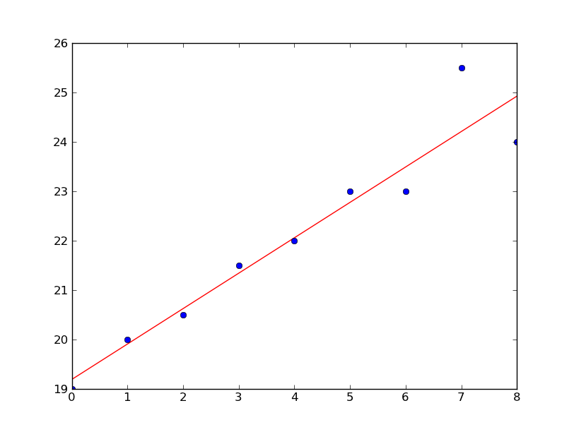
Scipy - Linear regressions
xi = arange(0,9) # linearly generated sequence y = [19, 20, 20.5, 21.5, 22, 23, 23, 25.5, 24] slope, intercept, r_value, p_value, std_err = stats.linregress(xi,y) print 'r value', r_value print 'p_value', p_value print 'standard deviation', std_err line = slope*xi+intercept plot(xi,line,'r-',xi,y,'o') show()
Scipy package

Slide 75
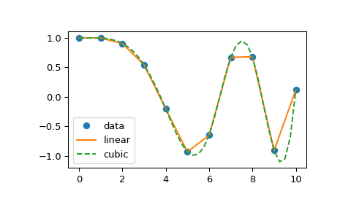
Scipy - Interpolation
>>> from scipy.interpolate import interp1d
>>> x = np.linspace(0, 10, num=11, endpoint=True) >>> y = np.cos(-x**2/9.0) >>> f = interp1d(x, y) >>> f2 = interp1d(x, y, kind='cubic') >>> xnew = np.linspace(0, 10, num=41, endpoint=True)
>>> import matplotlib.pyplot as plt >>> plt.plot(x, y, 'o', xnew, f(xnew), '-', xnew, f2(xnew), '--') >>> plt.legend(['data', 'linear', 'cubic'], loc='best') >>> plt.show()
Scipy package

Slide 76
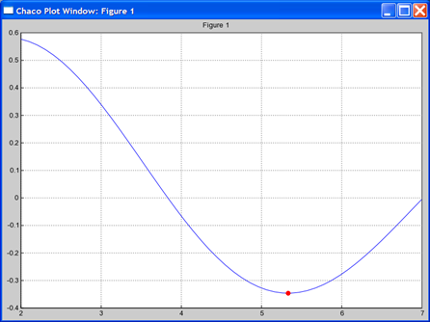
Scipy - Optimize
# minimize 1st order bessel # function between 4 and 7 >>> from scipy.special import j1 >>> from scipy.optimize import \ fminbound >>> x = r_[2:7.1:.1] >>> j1x = j1(x) >>> plot(x,j1x,’-’) >>> hold(True) >>> x_min = fminbound(j1,4,7) >>> j1_min = j1(x_min) >>> plot([x_min],[j1_min],’ro’)
Scipy package

Slide 77
Scipy - Exercises
Scipy package

Slide 78
5. Connecting Python (SQL, VBA, API)

Slide 79
SQL - Introduction
SQLite is a software library that provides a relational database management system.
The "lite" here means light weight in terms of setup, database administration, and required resource. One specificity of SQLite is that it is embedded in the end program, and allows to create / edit / delete databases directly from Python.
import sqlite3
Connecting Python (SQL, VBA, API)

Slide 80
SQL - Introduction
To use sqlite3 module, you must first create a connection object that represents the database. The below command will open a connection to the SQLite database file. If no database is found, it will create a new database in the current working directory of python. In the below example, we are creating a database named 'my_database.db' and it will be represented in python by the 'conn' object.
conn = sqlite3.connect('my_database20.db')
Once we have created the connection, we need to create a 'cursor' object in order to run SQL statements on the database:
cursor = conn.cursor()
Once finished:
conn.close()
Connecting Python (SQL, VBA, API)

Slide 81
SQL - Create a table
Cursor.execute allows to run an SQL statement. We will then use the SQL 'CREATE TABLE' command to create a new table. It requires a table name ('STOCKS' in our example) and then the columns of the table (ID, DATE, SYMBOL...) with for each column the data type (INT, TEXT, REAL...) and the option constraint (example: PRIMARY KEY).
cursor.execute('''CREATE TABLE STOCKS
(ID INT PRIMARY KEY,
DATE TEXT,
SYMBOL TEXT,
QUANTITY REAL,
PRICE REAL)''')
print("Table created successfully")
Connecting Python (SQL, VBA, API)

Slide 82
SQL - Insert content in a table
To insert data in the table, we run the SQL statement (Cursor.execute) 'INSERT INTO' which requires the name of the table ('STOCKS'), the keyword 'VALUES' and then the content of the new row to add in the table. a 'commit' statement is then required to save the record in the dataframe.
cursor.execute("INSERT INTO STOCKS VALUES (15, '2006-01-06','GOOG',100,35.14)")
conn.commit()
To insert several rows at once, we can use the 'executemany' statement as below:
purchases = [(230, '2006-03-28', 'IBM', 1000, 45.00),
(221, '2006-04-05', 'MSFT', 1000, 72.00),
(222, '2006-04-06', 'IBM', 500, 53.00),
]
cursor.executemany('INSERT INTO STOCKS VALUES (?,?,?,?,?)', purchases)
Connecting Python (SQL, VBA, API)

Slide 83
SQL - Delete a table
Using the DROP command we can delete an existing table:
cursor.execute("""
DROP TABLE STOCKS
""")
conn.commit()
Connecting Python (SQL, VBA, API)

Slide 84
SQL - Retrieve data from database
We can use the 'SELECT' method and iterate over the cursor object. In the below example we select all rows from the STOCKS table and print each row with a for loop.
for row in cursor.execute('SELECT * FROM STOCKS'):
print(row)
An alternative is to run the statement SELECT statement and then use the 'fetchall' command which outputs a list of tuple ( each tuple is a row of the table).
cursor.execute('SELECT * FROM STOCKS')
cursor.fetchall()
[(15, '2006-01-06', 'GOOG', 100.0, 35.14)]
Connecting Python (SQL, VBA, API)

Slide 85
SQL - Retrieve data from database
The SELECT statement can contains arguments in order for example to sort the table (ORDER BY), filter only the rows containing a requested value, or display only some columns. Three examples below:
cursor.execute('SELECT * FROM STOCKS ORDER BY price') # sort by PRICE
cursor.fetchall()
t = ('IBM',)
cursor.execute('SELECT * FROM STOCKS WHERE symbol=?', t) # Only filter the STOCKS table if symbol = IBM
cursor.fetchall()
cursor.execute('SELECT SYMBOL, QUANTITY FROM STOCKS WHERE symbol=?', t) # Only keep the SYMBOL/QUANTITY columns
cursor.fetchall()
Connecting Python (SQL, VBA, API)

Slide 86
SQL - Update / Delete operation
The following Python code shows how to update any record and then display the updated records using the UPDATE statement
cursor.execute("UPDATE STOCKS set PRICE = 999.00 where ID = 20")
cursor.execute('SELECT * FROM STOCKS')
cursor.fetchall()
Similarly, we can use a DELETE statement to remove rows from the table. In the example below, we remove from the table STOCKS the row with ID=21.
cursor.execute("DELETE from STOCKS where ID = 21")
conn.commit()
cursor.execute('SELECT * FROM STOCKS')
cursor.fetchall()
Connecting Python (SQL, VBA, API)

Slide 87
SQL - Pandas and SQL
Pandas Dataframe to DB:
import sqlite3
conn = sqlite3.connect('my_db.db')
df = pd.DataFrame(data=[[0, '10/11/12'], [1, '12/11/10']],columns=['int_column', 'date_column'])
df.to_sql('test_data', conn)
DB to pandas dataframe:
pd.read_sql('SELECT int_column, date_column FROM test_data', conn)
Connecting Python (SQL, VBA, API)

Slide 88
Python and VBA
VBA procedure to run a python:
Const PYTHON_EXE = "C:\python.exe"
Sub RunPythonScript(ByVal file As String)
Dim ExecPythonFile As String
ExecPythonFile = PYTHON_EXE + " " + file
Shell (ExecPythonFile)
End Sub
Connecting Python (SQL, VBA, API)

Slide 89
Python and VBA
sys.argv is a list in Python, which contains the command-line arguments passed to the script. If a user runs a in a command line:
python my_script.py x_tickers y_start_date
Within the python file my_script.py, the arguments x_tickers and y_start_date can be retrieved using the sys package / sys.argv list.
import sys
tickers=sys.argv[1]
start_date = sys.argv[2]
Connecting Python (SQL, VBA, API)

Slide 90
API for financial data: Yahoo
from pandas_datareader import data
import matplotlib.pyplot as plt
import pandas as pd
# Define the instruments to download. We would like to see Apple, Microsoft and the S&P500 index.
tickers = ['AAPL', 'MSFT', '^GSPC', '^TNX']
# We would like all available data from 01/01/2010 until 12/31/2020.
start_date = '2010-01-01'
end_date = '2020-12-31'
# User pandas_reader.data.DataReader to load the desired data. As simple as that.
panel_data = data.DataReader(tickers, 'yahoo', start_date, end_date)
panel_data.tail(5)
Connecting Python (SQL, VBA, API)

Slide 91
API for financial data: Bloomberg
Python API for Bloomberg actually calls the C++ API, so it is required to install both a Python package and the C++ SDK which is available here:
https://www.bloomberg.com/professional/support/api-library/
On Python package side, the official package is named blpapi, but other packages such as pdblp allow to retrieve Bloomberg data in a simple way:
https://pypi.org/project/pdblp/
https://matthewgilbert.github.io/pdblp/tutorial.html
import pdblp
import pandas as pd
con = pdblp.BCon().start()
underlying='SPX Index'
data=con.bdh(underlying, 'PX_LAST','20150629', '20200331', longdata=True)
Connecting Python (SQL, VBA, API)

Slide 92
API for financial data: Quandl
Quandl (https://www.quandl.com/) is a marketplace for economic and financial data. It contains a wide range of historical time series on most asset classes (Equity, Fixed Income, Commodities), as well as economic / alternative data. A Python API is available in order to directly pull data from Quandl.
Once you have created an account and got you account key, you just need to know the ticker of the underlying you need the data from. The python code would look like:
import quandl
df=quandl.get("EOD/DIS", authtoken="zbzphcQYstaEEmzXfs_F")
df.head(5)
Connecting Python (SQL, VBA, API)

Slide 93
WEB Scraping
Web scraping is the process of gathering information from the Internet. Python based web scraping can allow to:
Automate repetitive tasks to gather information
Monitor web data which is not directly available from an API (Bloomberg / Yahoo…)
Automate some action (logging / upload information)
Beautiful Soup is a Python library for parsing structured data. It allows you to interact with HTML in a similar way to how you interact with a web page using developer tools. The library exposes a couple of intuitive functions you can use to explore the HTML you received. To get started, use your terminal to install Beautiful Soup:
Connecting Python (SQL, VBA, API)

Slide 94
WEB Scraping
import requests
from bs4 import BeautifulSoup
URL="https://live.euronext.com/en/product/indices/FR0003500008-XPAR"
page = requests.get(URL)
soup = BeautifulSoup(page.content, "html.parser")
Connecting Python (SQL, VBA, API)

Slide 95
WEB Scraping
from selenium import webdriver
from selenium.webdriver.support.ui import Select
from selenium.webdriver.common.keys import Keys
url = "https://zzz/account/index.html"
browser = webdriver.Chrome(executable_path=r"C:\chromedriver.exe")
# Navigate to your url
browser.get(url)
browser.find_element_by_name("st_username").clear()
Connecting Python (SQL, VBA, API)

Slide 96

Interactive dashboards with Jupyter
Interactive dashboards in Jupyter can be achieved by using the ipywidgets module. Widgets are eventful python objects that have a representation in the browser, often as a control like a slider, textbox, etc.
!pip install ipywidgets
import ipywidgets as widgets
Widgets have their own display repr which allows them to be displayed using IPython's display framework. Constructing and returning an IntSlider automatically displays the widget (as seen below). Widgets are displayed inside the output area below the code cell. Clearing cell output will also remove the widget.
widgets.IntSlider()
Interactive dashboards

Slide 97
Interactive dashboards with Jupyter
Editing the widget properties:
w = widgets.IntSlider()
display(w)
w.max = 200
Generating a text widget
widgets.Text(value='Hello',disable=False)
Interactive dashboards

Slide 98
Interactive dashboards with Jupyter
import matplotlib.pyplot as plt
import math
import scipy.stats
from ipywidgets import interactive
import ipywidgets as widgets
def fexp(a,b,c,x):
return a+b*x+c*x*x
def plotfunc(a, b, c):
xrange=range(0,50)
prices=[fexp(a,b,c,x) for x in xrange]
plt.figure(figsize=(8,5)) # Initiate the graph
plt.plot(xrange, prices, c='k', lw=3)
plt.grid(True)
plt.show()
y=interactive(plotfunc, a=(0, 10, 1), b=(0, 10, 1), c=(0, 10, 1))
display(y)
Interactive dashboards

Slide 99
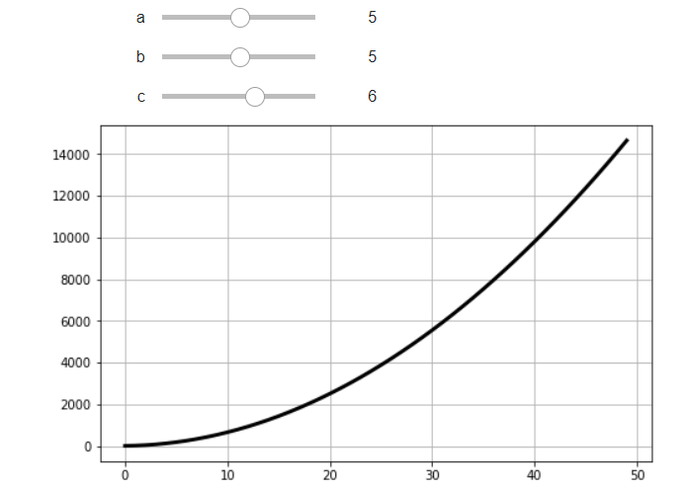
Interactive dashboards with Jupyter
Interactive dashboards

Slide 100
Exercises
Connecting Python (SQL, VBA, API)

Slide 101
6. Multi-Threading
Multi-Processing

Slide 102
Threading
Threading is one of the ways in which Python allows you to write programs which are executed in parallel, and seem to execute several tasks at the same time.
In Python the Thread class from the threading module represents an activity
that is run in a separate thread of execution within a single process. These threads of
execution are lightweight
A thread is lightweight:
It does not possess its own address space and it is not treated as a separate
entity by the host operating system; it is not a process
Multi Processing

Slide 103
Thread states
When a thread object is first created it exists, but it is not yet runnable.
It is then started, and becomes runnable.
It may then switch back and forth between a state running and runnable
The switch between “running” and “runnable” is managed by a scheduler which is responsible for managing multiple threads
Once its run() method terminates, the thread has finished execution and is now dead
A Thread may also be in a waiting state; for example, when it is waiting for another thread to finish its work before continuing (possibly because it needs the results produced by that thread to continue). This can be achieved using the join() method
Multi Processing

Slide 104
Instantiating the Thread Class
The Thread class can be found in the threading module and therefore must be
imported prior to use. The class Thread defines a single constructor that takes up to six optional arguments:
class threading.Thread(group=None,
target=None,
name=None,
args=(),
kwargs={})
With:
group should be None; reserved when a ThreadGroup class is implemented.
target is the callable object to be invoked by the run() method. Defaults to None
name is the thread name. By default, a unique name is constructed of the form “Thread-N” where N is an integer.
args is the argument tuple for the target invocation. Defaults to (). If a single argument is provided the tuple is not required.
kwargs is a dictionary of keyword arguments for the target invocation. Defaults to {}.
Multi Processing

Slide 105
Instantiating the Thread Class
Example:
from threading import Thread
def simple_function():
print("skema")
# Create a new thread and start it
# The thread will run the function
t1 = Thread(target=simple_function)
t1.start()
In this example, the thread t1 will execute the function simple_function. The main code will be executed by the main thread that is present when the program starts; there are then two threads used in the above program; main and t1.
Multi Processing

Slide 106
Thread Class: the join() method
The join() method can cause one thread to wait for another to complete. For
example, if we want the main thread to wait until a thread completes before it prints
the done message:
from threading import Thread
from time import sleep
def print_and_wait():
for i in range(0, 10):
print('.', end='')
sleep(1)
print('Starting')
t = Thread(target=print_and_wait) # Create read object with reference to target function
t.start() # Start the thread object
t.join() # Wait for the thread to complete
print('\nDone')
Multi Processing

Slide 107
Passing arguments to a thread
Many functions expect to be given a set of parameter values when they are run;
these arguments still need to be passed to the function via a separate thread. These parameters can be passed to the function to be executed via the args parameter, for example:
from threading import Thread
from time import sleep
def my_function(msg):
for i in range(0, 10):
print(msg, end='', flush=True)
sleep(1)
print('Starting')
t1 = Thread(target=my_function, args='A')
t2 = Thread(target=my_function, args='B')
t1.start()
t2.start()
print('Done')
Multi Processing

Slide 108
The Timer Class
The Timer class represents an action (or task) to run after a certain amount of time has elapsed. The Timer class is a subclass of Thread and as such also functions as an example of creating custom threads.
The Timer class is built as: Timer(interval, function, args = None, kwargs = None)
In the below example, the Timer would run the print_name function after an initial delay of 3 s.
from threading import Timer
def print_name():
print('name')
print('Starting')
t = Timer(3, print_name)
t.start()
t.join()
print('Done')
Multi Processing

Slide 109
Exercise on Threads
Multi Processing

